Slide 1
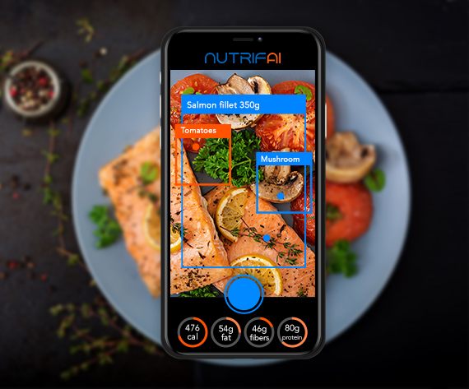


Food Detection To Recipe Project
Shira Shanny
Shay Barom
Avishay Aknin

Slide 2
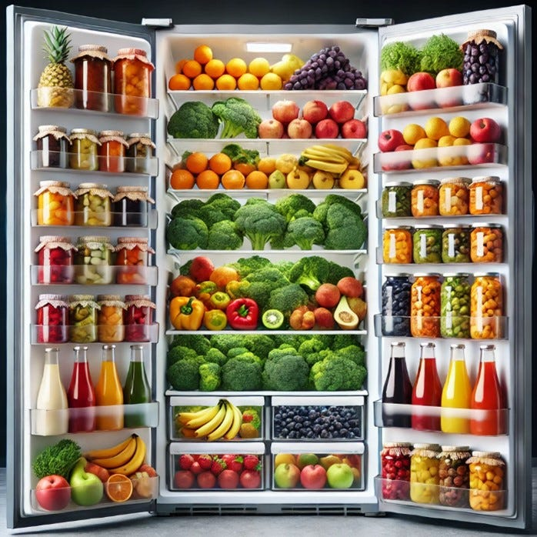
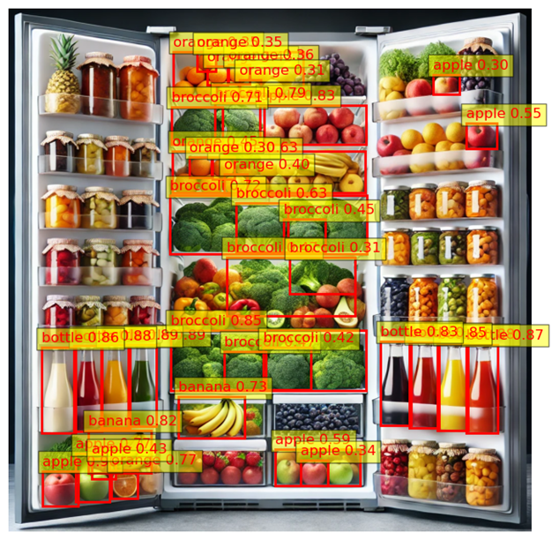
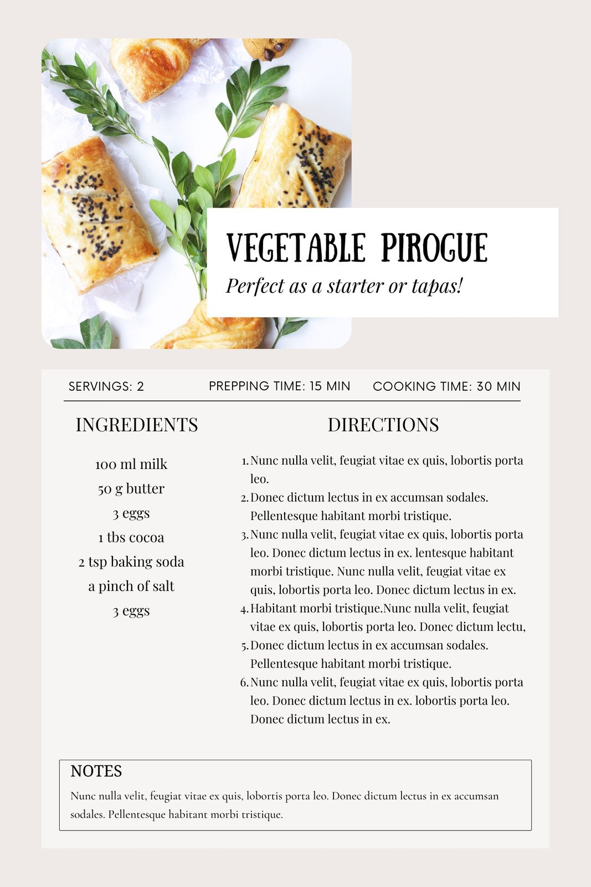

Goal / vision
User input
Food Detection and Analysis
Recipe Generation

Slide 3
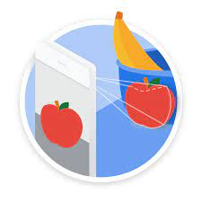

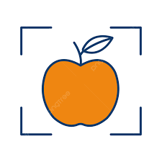
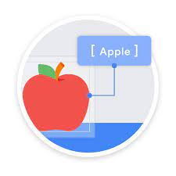

Use Case Scenario
User Input
User uploads video or image files.
Video Processing
Adjust speed, color, and confidence levels, then split the video into images.
Image Analysis
Segment images by shelves and detect ingredients.
Result Display
View and edit detected ingredients, then generate structured recipes.
Recipe Workflow
Automatically create recipes based on detected ingredients.

Slide 4

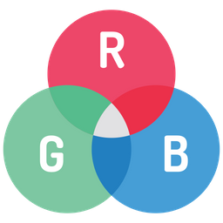
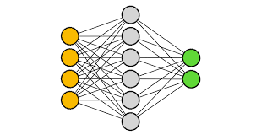
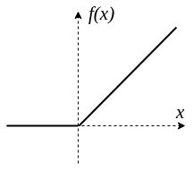
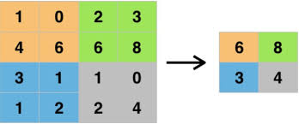



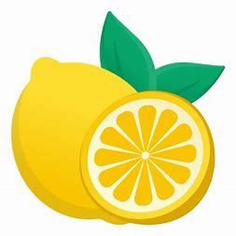
Image detection- Initial CNN Levels
Input Layer Accepts RGB images as input (3 channels).
Convolutional Layers
Conv1: Extracts low-level features (edges, textures).
Conv2: Captures mid-level patterns (shapes).
Conv3: Detects high-level patterns (objects).
Activation & Pooling
ReLU: Adds non-linearity for learning complex patterns.
MaxPooling: Reduces spatial dimensions, retains key features.
Fully Connected Layers
FC1: Connects flattened features for feature abstraction.
FC2: Classifies into target categories.
Output Layer Produces probabilities for each class.

Slide 5
Image detection - Resnet50
FastAI base model (class 2) – with resnet 50 (duckduckgo images) – medium performances
Class 9 code (duckduckgo images) - low performances
Class 9 code – AI made (stable diffusion) train images of fridge front view – medium performances
Class 9 code – AI made images + test image split per shelf – good performance
Class 9 code – AI made images + test image split per half shelf – very good performances

Slide 6
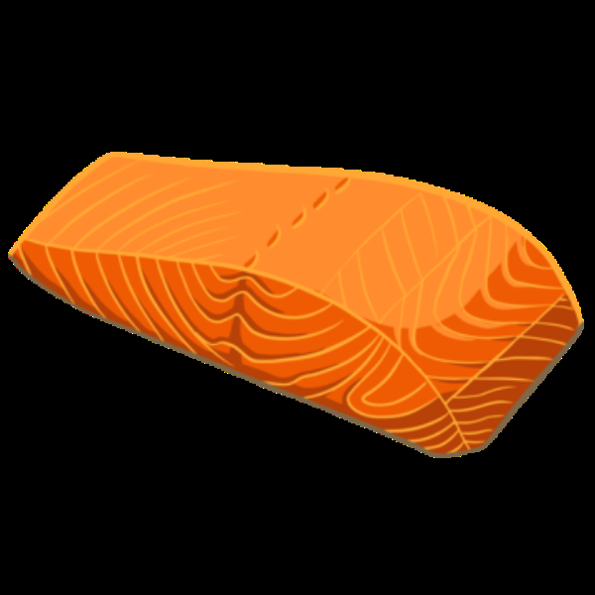
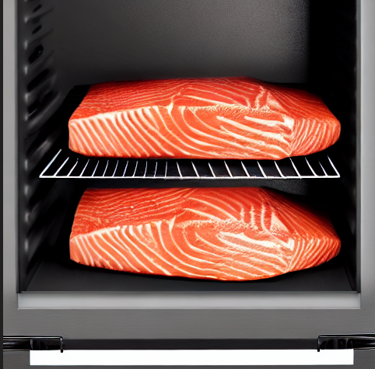
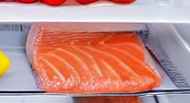
Fast AI
Train Photos
AI Made picture
Cropped AI made picture

Slide 7
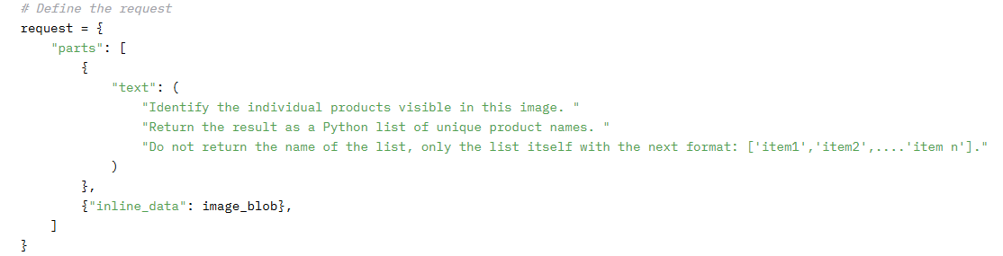

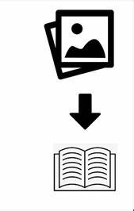
LLM - Gemini API(image to text)
Free API (limited usage)
Very good performance – way better than resnet50.
Response request should be very accurate

Slide 8

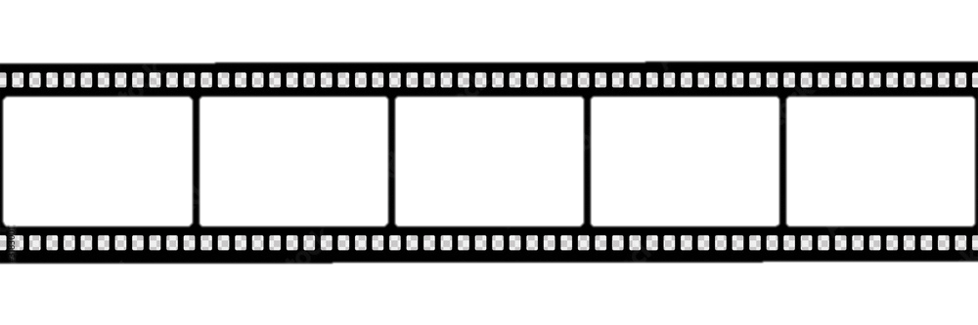
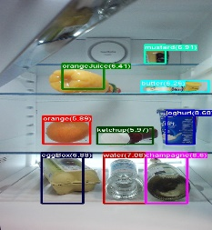
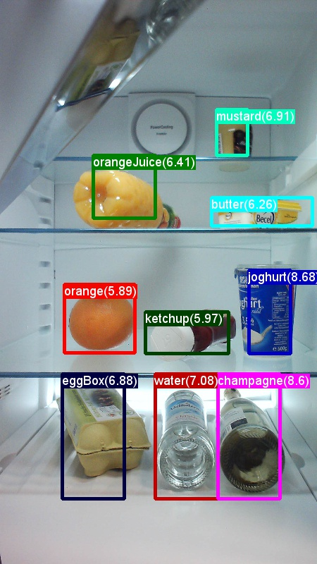
Video Processing Levels - Resnet50 /Yolo
Upload Video Accept and process video file.
Extract Frames Split video into individual frames.
Object Detection Use YOLO to detect objects.
Ingredient Classification Match objects to ingredients with FastAI.
Annotation & Output
Highlight objects with labels.
Display detections, crops, and recipes.
Recreate video with annotations.
Yolo
Resnet50
APPLE – 0.8
BANANA -0.5

Slide 9
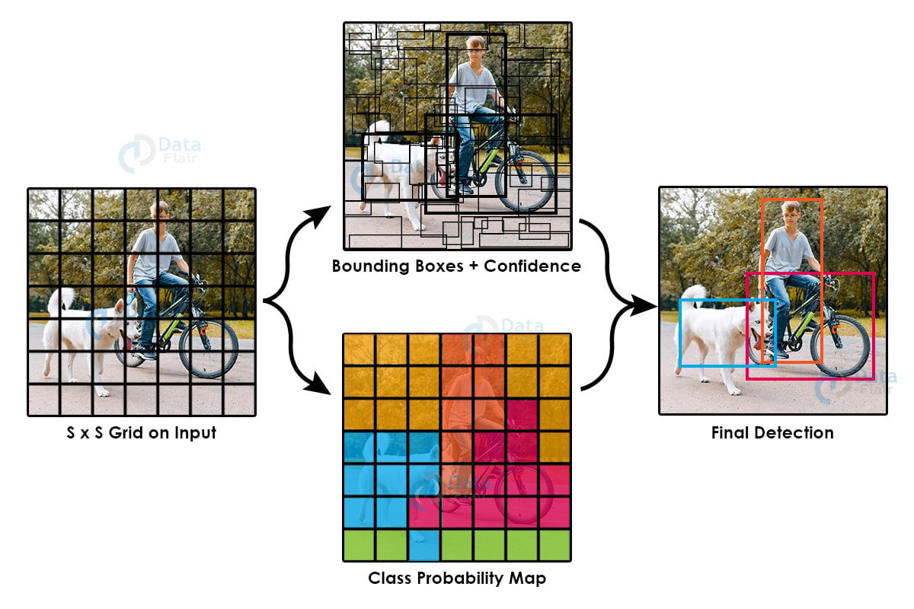
Yolo procedure
Create manual dataset.yaml
(include the new classes to be added)
Download IOD annotated data
Convert to YOLO annotations
Organize directories
Train pretrained model on custom data
Test and performance evaluation

Slide 10
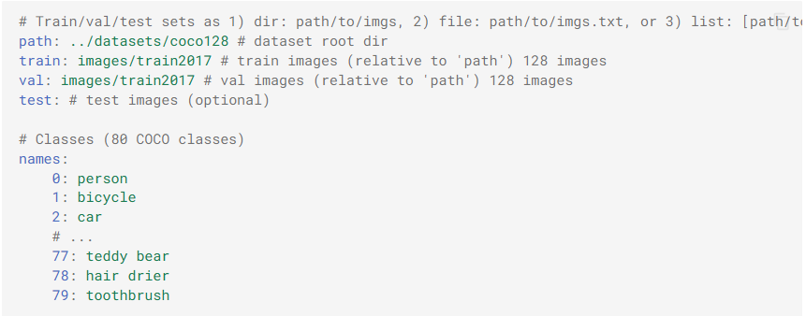
Yolo - Pretrained Model
All YOLO models available online are train on COCO dataset which contains 80 classes from different subjects
We needed it to recognize food ingredients, and the classes of food products are very limited
Therefore, we had to train it on more classes
Create Dataset.yaml
We added our new classes to the basic COCO.yaml file following these instructions:

Slide 11
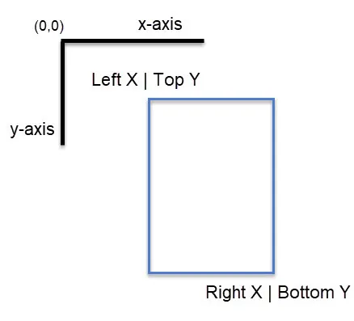
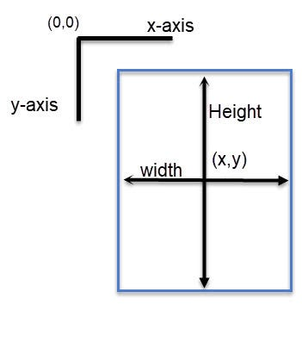
Yolo - Data Preparation
YOLO accepts data in a certain annotation and a certain folder organization of the data:
name_of_class x y width height
x,y are the coordinates of the center of the rectangular
There is a tagged dataset of more food classes called OID which has different annotation:
name_of_the_class left top right bottom
The left top and right bottom are 2 corners of the rectangular
We download the data and then used convertor to change the annotation to fit YOLO needs using OIDtoYOLOconverter.py
OID to YOLO annotation conversion
Link to source

Slide 12
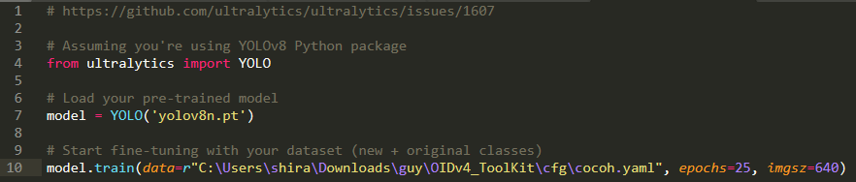
Yolo - Train Custom Data
We trained for 25 epochs and got not so good results

Slide 13
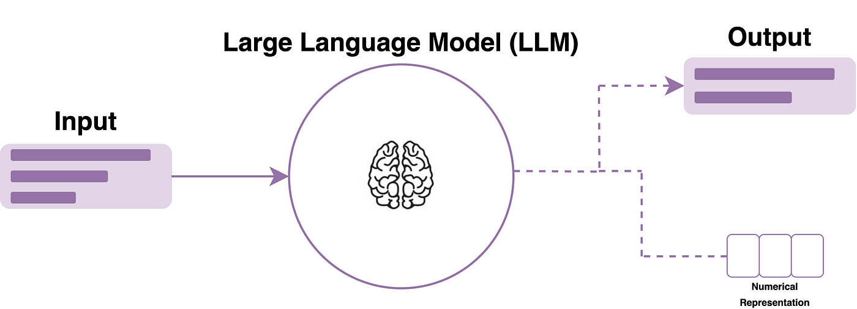

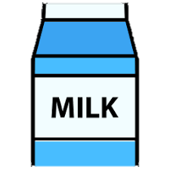


LLM Groq - Code Levels (text to text)
Product Detection Get a list of detected products from video or image.
Role Setup Defines assistant as a chef.
Prompt Design Combines system and user inputs.
Model Initialization Configures ChatGroq with API.
Response Execution Processes and integrates LLM results.

Slide 14

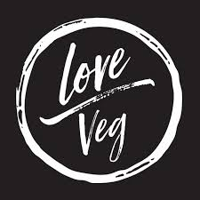
Future Improvements
Refine Algorithms: Transition to advanced multimodal models like CLIP for improved ingredient detection and contextual understanding.
Expand Data Quality: Use APIs like Google Images to dynamically update datasets with high-quality and diverse ingredient images.
Enhance Accessibility: Replace Streamlit with a mobile app for faster video processing and integrate a Telegram bot for users to upload videos, receive detections, and generate recipes in real time.
Ensure Reliability: Implement federated learning to continuously improve model performance based on user feedback while maintaining data privacy
Enhance Features: Generate vegetarian or Paleo recipes using suitable UX/UI, choose between different kinds of meal: desert, launch, etc…

Slide 15

Challenges
Real-Time Processing:
Running models efficiently on video data while maintaining fast processing speeds.
Multi-Object Detection:
Recognizing and classifying multiple objects in complex environments, like a refrigerator with shelfs.
Custom Model Development:
Limited pre-trained models (like yolo), requiring custom training for specific objects.
Data Management:
Organizing and labeling large datasets for accurate model training.
Integration & Upload:
Combining models into a smooth workflow and handling real-time server uploads.

Slide 16
Summery
Successes:
Integrated AI models for smooth detection and recipe generation.
Accurately identified items in various fridge setups.
Generated practical, user-friendly recipes based on detected ingredients.
Obstacles:
Handling varied image quality, lighting, and clutter in fridge photos.
Building a diverse dataset to cover different food types.
Ensuring the recipe suggestions were both relevant and creative.
Learnings:
Importance of robust data preparation for real-world accuracy.
Balancing model complexity with user-friendly performance.
The value of testing with real users to refine outputs.

